Slide 1
Edk2 Address Sanitizer and Undefined Behavior Sanitizer
Shi Steven
Oct, 2017
Notes:
https://github.com/google/sanitizers/wiki/AddressSanitizer
https://github.com/google/sanitizers/wiki/AddressSanitizerAlgorithm
https://github.com/google/sanitizers/wiki/AddressSanitizerHowToContribute
https://www.usenix.org/system/files/conference/atc12/atc12-final39.pdf
https://developer.apple.com/videos/play/wwdc2015/413/
https://youtu.be/V2_80g0eOMc
https://github.com/CppCon/CppCon2014/blob/master/Presentations/Sanitize%20your%20C%2B%2B%20code/Sanitize%20your%20C%2B%2B%20code%20-%20Kostya%20Serebryany%20-%20CppCon%202014.pdf
https://developer.apple.com/videos/play/wwdc2015/413/
https://github.com/google/syzkaller
https://lwn.net/Articles/677764/
https://www.kernel.org/doc/Documentation/kasan.txt
http://www.strlen.de/talks/debug-w-syzkaller.pdf
https://www.youtube.com/watch?v=Acp0A9X1254
https://github.com/google/kasan/wiki

Slide 2

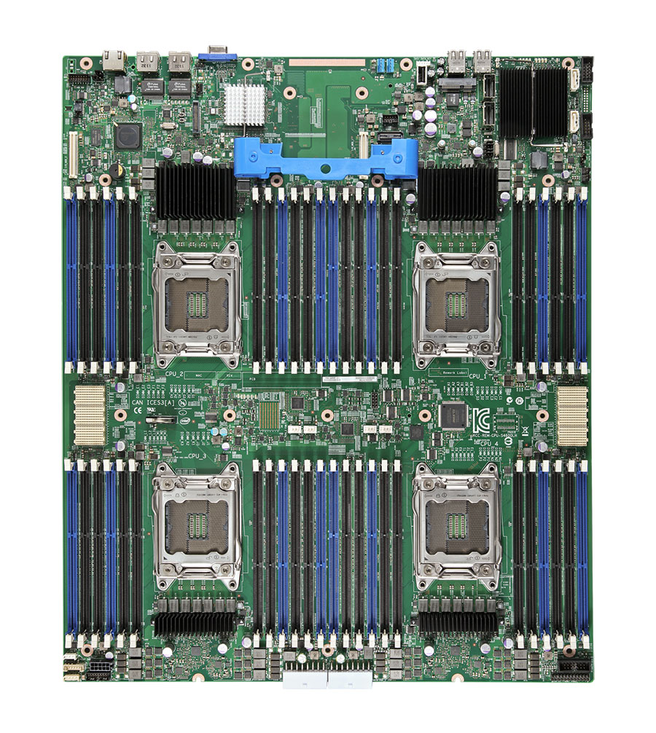
Edk2 Address Sanitizer (Asan)
A new build toolchain and library to enable LLVM address sanitizer in edk2
https://clang.llvm.org/docs/AddressSanitizer.html
Detects memory access errors dynamically (e.g. buffer-overflow, Use-after-free)
Already found many long-time existing (e.g. ~8 years) bugs
Violation call stack with
source code symbol info
Edk2 ASanlib
Clang
-fsanitize=address
Symbolizer
tool
Run the image
Uefi Source code
Asan instrumented firmware Image
Memory access violations log

Slide 3
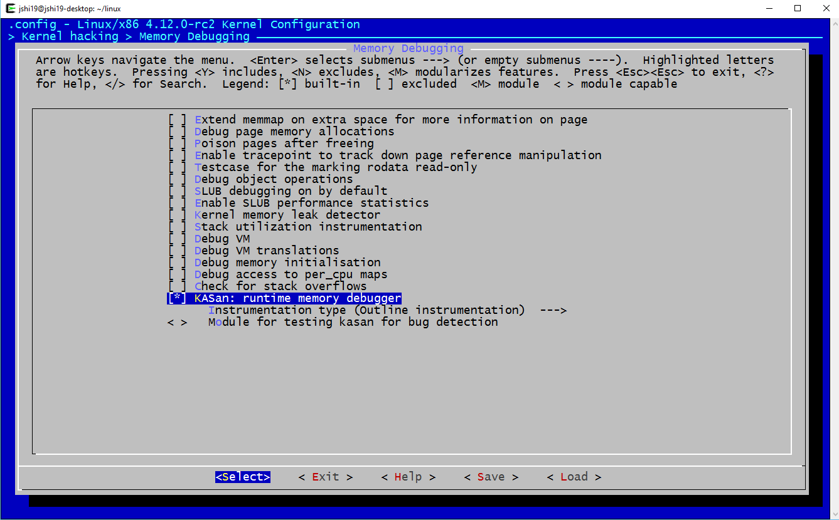
Address Sanitizer in Linux Kernel (KASAN)
Kasan is the only fault built-in Memory Debugging tool in Linus Torvalds’s tree: https://github.com/torvalds/linux
Notes:
https://github.com/google/kasan/wiki
https://gcc.gnu.org/onlinedocs/gcc/Instrumentation-Options.html
https://github.com/google/syzkaller
https://lwn.net/Articles/677764/
https://www.kernel.org/doc/Documentation/kasan.txt
http://www.strlen.de/talks/debug-w-syzkaller.pdf
https://www.youtube.com/watch?v=Acp0A9X1254
http://events.linuxfoundation.org/sites/events/files/slides/Alexander_Popov-KASan_in_a_Bare-Metal_Hypervisor_0.pdf

Slide 4

Address Sanitizer in Apple Xcode
Apple Xcode has integrated the LLVM sanitizers since 2015 (https://developer.apple.com/videos/play/wwdc2015/413/)

Slide 5
Part of found bugs of Edk2 in 2017 (only open source part)
https://bugzilla.tianocore.org/show_bug.cgi?id=567
https://bugzilla.tianocore.org/show_bug.cgi?id=566
https://bugzilla.tianocore.org/show_bug.cgi?id=547
https://bugzilla.tianocore.org/show_bug.cgi?id=749
https://bugzilla.tianocore.org/show_bug.cgi?id=640
https://bugzilla.tianocore.org/show_bug.cgi?id=638
https://bugzilla.tianocore.org/show_bug.cgi?id=639
https://bugzilla.tianocore.org/show_bug.cgi?id=637
https://bugzilla.tianocore.org/show_bug.cgi?id=654
https://bugzilla.tianocore.org/show_bug.cgi?id=601
https://bugzilla.tianocore.org/show_bug.cgi?id=690
https://bugzilla.tianocore.org/show_bug.cgi?id=695
https://bugzilla.tianocore.org/show_bug.cgi?id=697
https://bugzilla.tianocore.org/show_bug.cgi?id=698
https://bugzilla.tianocore.org/show_bug.cgi?id=699
https://bugzilla.tianocore.org/show_bug.cgi?id=702
https://bugzilla.tianocore.org/show_bug.cgi?id=704
https://bugzilla.tianocore.org/show_bug.cgi?id=705
https://bugzilla.tianocore.org/show_bug.cgi?id=733
https://bugzilla.tianocore.org/show_bug.cgi?id=742
https://bugzilla.tianocore.org/show_bug.cgi?id=783
https://bugzilla.tianocore.org/show_bug.cgi?id=883

Slide 6
Memory access violation call stack symbol info example
[Asan_bug] Use-after-free runtime memory in CoreInstallConfigurationTable()
https://vthsd.intel.com/hsd/tiano/tracker/default.aspx?tracker_id=220133&hsdmsgstr=1
WriteUnaligned64 /home/jshi19/wksp_efi/git_pilot-edk2/MdePkg/Library/BaseLib/Unaligned.c:221:18
CopyGuid /home/jshi19/wksp_efi/git_pilot-edk2/MdePkg/Library/BaseMemoryLibRepStr/MemLibGuid.c:55:14
CoreInstallConfigurationTable /home/jshi19/wksp_efi/git_pilot-edk2/MdeModulePkg/Core/Dxe/Misc/InstallConfigurationTable.c:152:49
InstallMemoryAttributesTable /home/jshi19/wksp_efi/git_pilot-edk2/MdeModulePkg/Core/Dxe/Misc/MemoryAttributesTable.c:198:12
InstallMemoryAttributesTableOnMemoryAllocation /home/jshi19/wksp_efi/git_pilot-edk2/MdeModulePkg/Core/Dxe/Misc/MemoryAttributesTable.c:224:1
CoreFreePool /home/jshi19/wksp_efi/git_pilot-edk2/MdeModulePkg/Core/Dxe/Mem/Pool.c:607:10
CoreInstallConfigurationTable /home/jshi19/wksp_efi/git_pilot-edk2/MdeModulePkg/Core/Dxe/Misc/InstallConfigurationTable.c:139:9

Slide 7
Future Plan
Enable GCC Asan as well (How about Xcode?)
Combine fuzzy testing
Open source into edk2 in Q3 after we fix the found bugs

Slide 8
Thank You

Slide 9


AddressSanitizer (a.k.a Asan) is very necessary to Fuzzers
There are two requirements to find a mine (e.g. buffer overflow bug) in a multiply-path jungle (Firmware)
1. Get to the right place through specific path
Code coverage guided methods (Fuzzing or Symbolic Execution Input) are to arrive different path as more as possible
2. Have a strong mine detector
Sanitizers, like Asan, are better mine detectors than just system crash to not let bug missing
Notes:
https://github.com/google/sanitizers/wiki/AddressSanitizer
https://github.com/google/sanitizers/wiki/AddressSanitizerAlgorithm
https://github.com/google/sanitizers/wiki/AddressSanitizerHowToContribute
https://www.usenix.org/system/files/conference/atc12/atc12-final39.pdf
https://developer.apple.com/videos/play/wwdc2015/413/
The instrumentation module modifies the code to check the shadow state for each memory access and creates poisoned redzones around stack and global objects to detect overflows and underflows. The current implementation is based on the LLVM [4] compiler infrastructure. The run-time library replaces malloc, free and related functions, creates poisoned redzones around allocated heap regions, delays the reuse of freed heap regions, and does error reporting AddressSanitizer (a.k.a Asan) is good supplement to Fuzzers

Slide 10
AddressSanitizer (a.k.a Asan) is very important to Fuzzers
State-of-art Fuzzers support and even depend on Asan
AFL (support Asan)
https://github.com/mirrorer/afl/blob/master/docs/notes_for_asan.txt
LibFuzzer (nearly depend on Asan)
http://llvm.org/docs/LibFuzzer.html
Syzkaller (nearly depend on KAsan)
https://github.com/google/syzkaller
https://lwn.net/Articles/677764/
Notes:
https://github.com/google/sanitizers/wiki/AddressSanitizer
https://github.com/google/sanitizers/wiki/AddressSanitizerAlgorithm
https://github.com/google/sanitizers/wiki/AddressSanitizerHowToContribute
https://www.usenix.org/system/files/conference/atc12/atc12-final39.pdf
https://developer.apple.com/videos/play/wwdc2015/413/
The instrumentation module modifies the code to check the shadow state for each memory access and creates poisoned redzones around stack and global objects to detect overflows and underflows. The current implementation is based on the LLVM [4] compiler infrastructure. The run-time library replaces malloc, free and related functions, creates poisoned redzones around allocated heap regions, delays the reuse of freed heap regions, and does error reporting

Slide 11
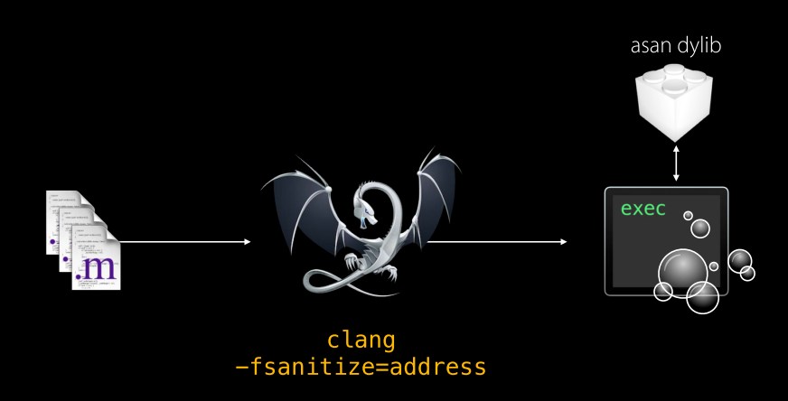
Our Plan&Tasks – Edk2 Sanitizer Libs
Edk2 Sanlib

Slide 12
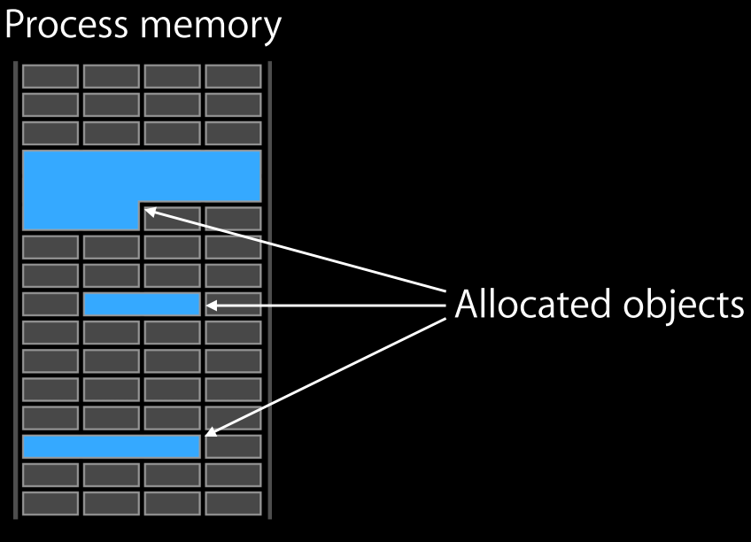
Asan Shadow memory for Object Isolation
Notes:
https://en.wikipedia.org/wiki/Shadow_memory
Shadow memory is a technique used to track and store information on computer memory used by a program during its execution. Shadow memory consists of shadow bytes that map to individual bits or one or more bytes in main memory. These shadow bytes are typically invisible to the original program and are used to record information about the original piece of data.
The technique is utilized by memory-error checkers that can store information on which parts of memory have been allocated to the program being checked. This shadow memory is then used for detecting and reporting incorrect accesses of memory, even though the program may not be crashing due to a segmentation fault or similar. An error checker may also store additional information on memory such as which bits have defined and which ones do not. Memcheck, part of the Valgrind suite uses this to detect undefined behavior resulting from acting on or printing undefined memory values.
Use of shadow memory is however not limited to memory-error checkers, as what information is stored in these shadow bytes is not fixed. It is for instance used by ThreadSanitizer, a data race detector.
Shadow memory can be both implemented and used a lot of different ways, and have different performance characteristics. Memcheck for instance tracks values with bit precision, while AddressSanitizer, part of the clang compiler, is comparatively very fast. Memcheck, as all Valgrind tools, use binary translation and instrumentation to run code manipulating the shadow memory corresponding to program memory use. AddressSanitizer on the other hand is created on compile-time and inserts error-checking code inline into a program during compilation. Its shadow-memory implementation uses a huge reservation of virtual memory for its shadow memory, giving very different performance characteristics.
adjacent memory protection

Slide 13
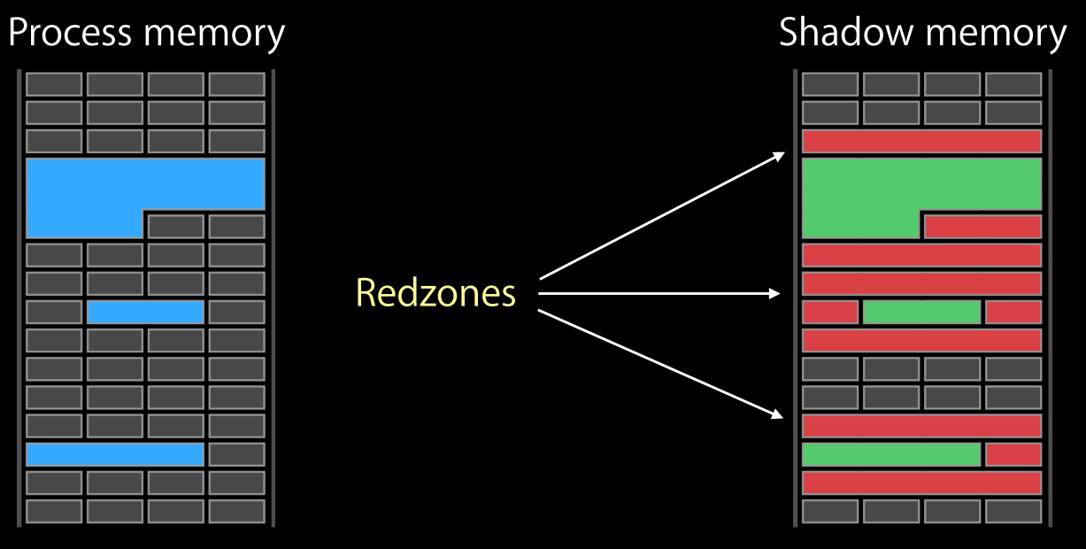
ASan Shadow memory for Object Isolation
Notes:
https://en.wikipedia.org/wiki/Shadow_memory
Shadow memory is a technique used to track and store information on computer memory used by a program during its execution. Shadow memory consists of shadow bytes that map to individual bits or one or more bytes in main memory. These shadow bytes are typically invisible to the original program and are used to record information about the original piece of data.
The technique is utilized by memory-error checkers that can store information on which parts of memory have been allocated to the program being checked. This shadow memory is then used for detecting and reporting incorrect accesses of memory, even though the program may not be crashing due to a segmentation fault or similar. An error checker may also store additional information on memory such as which bits have defined and which ones do not. Memcheck, part of the Valgrind suite uses this to detect undefined behavior resulting from acting on or printing undefined memory values.
Use of shadow memory is however not limited to memory-error checkers, as what information is stored in these shadow bytes is not fixed. It is for instance used by ThreadSanitizer, a data race detector.
Shadow memory can be both implemented and used a lot of different ways, and have different performance characteristics. Memcheck for instance tracks values with bit precision, while AddressSanitizer, part of the clang compiler, is comparatively very fast. Memcheck, as all Valgrind tools, use binary translation and instrumentation to run code manipulating the shadow memory corresponding to program memory use. AddressSanitizer on the other hand is created on compile-time and inserts error-checking code inline into a program during compilation. Its shadow-memory implementation uses a huge reservation of virtual memory for its shadow memory, giving very different performance characteristics.

Slide 14
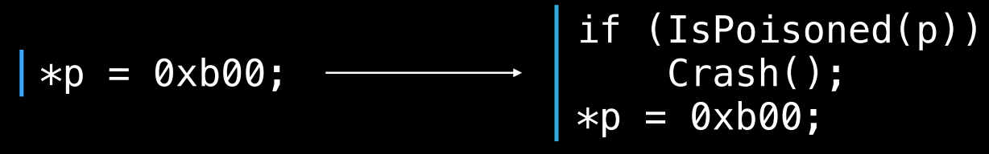
ASan Shadow memory for Object Isolation
Notes:
https://en.wikipedia.org/wiki/Shadow_memory
Shadow memory is a technique used to track and store information on computer memory used by a program during its execution. Shadow memory consists of shadow bytes that map to individual bits or one or more bytes in main memory. These shadow bytes are typically invisible to the original program and are used to record information about the original piece of data.
The technique is utilized by memory-error checkers that can store information on which parts of memory have been allocated to the program being checked. This shadow memory is then used for detecting and reporting incorrect accesses of memory, even though the program may not be crashing due to a segmentation fault or similar. An error checker may also store additional information on memory such as which bits have defined and which ones do not. Memcheck, part of the Valgrind suite uses this to detect undefined behavior resulting from acting on or printing undefined memory values.
Use of shadow memory is however not limited to memory-error checkers, as what information is stored in these shadow bytes is not fixed. It is for instance used by ThreadSanitizer, a data race detector.
Shadow memory can be both implemented and used a lot of different ways, and have different performance characteristics. Memcheck for instance tracks values with bit precision, while AddressSanitizer, part of the clang compiler, is comparatively very fast. Memcheck, as all Valgrind tools, use binary translation and instrumentation to run code manipulating the shadow memory corresponding to program memory use. AddressSanitizer on the other hand is created on compile-time and inserts error-checking code inline into a program during compilation. Its shadow-memory implementation uses a huge reservation of virtual memory for its shadow memory, giving very different performance characteristics.

Slide 15
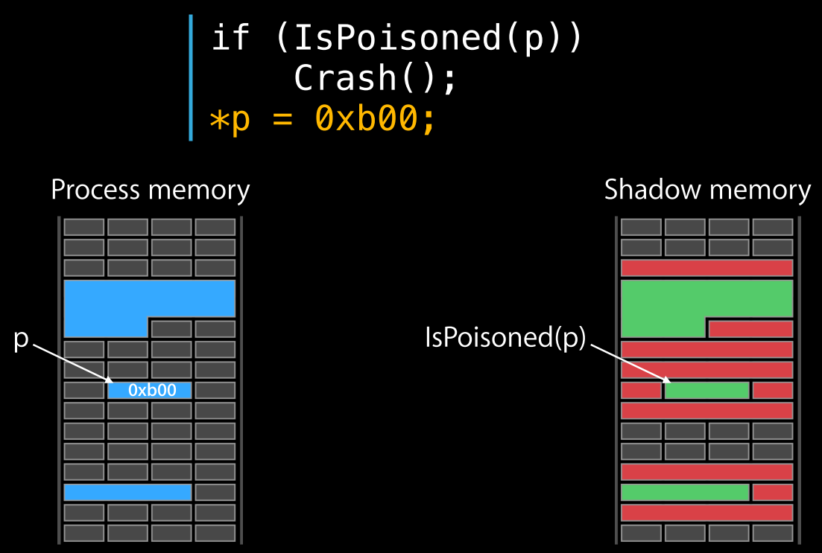
ASan Shadow memory for Object Isolation
Notes:
https://en.wikipedia.org/wiki/Shadow_memory
Shadow memory is a technique used to track and store information on computer memory used by a program during its execution. Shadow memory consists of shadow bytes that map to individual bits or one or more bytes in main memory. These shadow bytes are typically invisible to the original program and are used to record information about the original piece of data.
The technique is utilized by memory-error checkers that can store information on which parts of memory have been allocated to the program being checked. This shadow memory is then used for detecting and reporting incorrect accesses of memory, even though the program may not be crashing due to a segmentation fault or similar. An error checker may also store additional information on memory such as which bits have defined and which ones do not. Memcheck, part of the Valgrind suite uses this to detect undefined behavior resulting from acting on or printing undefined memory values.
Use of shadow memory is however not limited to memory-error checkers, as what information is stored in these shadow bytes is not fixed. It is for instance used by ThreadSanitizer, a data race detector.
Shadow memory can be both implemented and used a lot of different ways, and have different performance characteristics. Memcheck for instance tracks values with bit precision, while AddressSanitizer, part of the clang compiler, is comparatively very fast. Memcheck, as all Valgrind tools, use binary translation and instrumentation to run code manipulating the shadow memory corresponding to program memory use. AddressSanitizer on the other hand is created on compile-time and inserts error-checking code inline into a program during compilation. Its shadow-memory implementation uses a huge reservation of virtual memory for its shadow memory, giving very different performance characteristics.

Slide 16
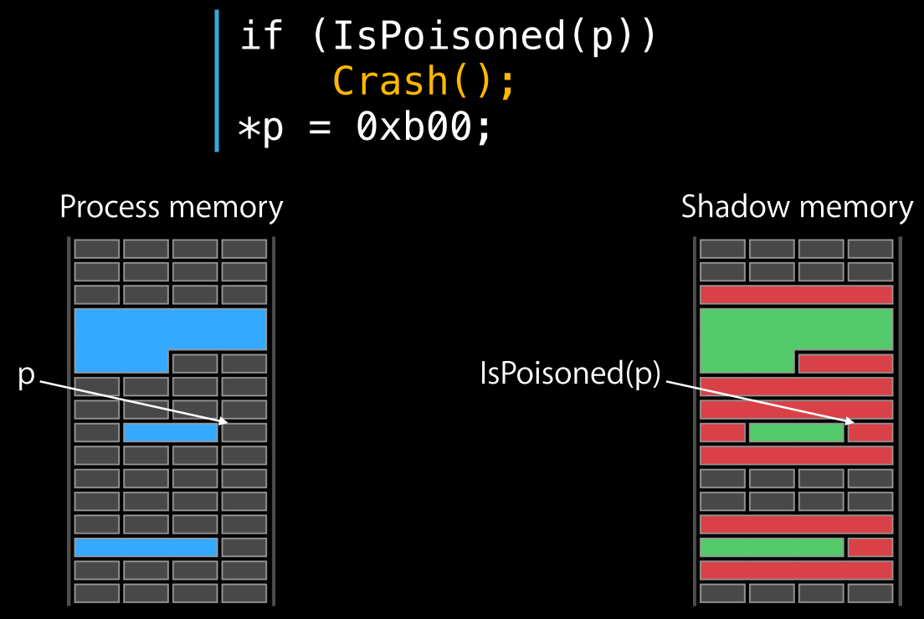
ASan Shadow memory for Object Isolation
Notes:
https://en.wikipedia.org/wiki/Shadow_memory
Shadow memory is a technique used to track and store information on computer memory used by a program during its execution. Shadow memory consists of shadow bytes that map to individual bits or one or more bytes in main memory. These shadow bytes are typically invisible to the original program and are used to record information about the original piece of data.
The technique is utilized by memory-error checkers that can store information on which parts of memory have been allocated to the program being checked. This shadow memory is then used for detecting and reporting incorrect accesses of memory, even though the program may not be crashing due to a segmentation fault or similar. An error checker may also store additional information on memory such as which bits have defined and which ones do not. Memcheck, part of the Valgrind suite uses this to detect undefined behavior resulting from acting on or printing undefined memory values.
Use of shadow memory is however not limited to memory-error checkers, as what information is stored in these shadow bytes is not fixed. It is for instance used by ThreadSanitizer, a data race detector.
Shadow memory can be both implemented and used a lot of different ways, and have different performance characteristics. Memcheck for instance tracks values with bit precision, while AddressSanitizer, part of the clang compiler, is comparatively very fast. Memcheck, as all Valgrind tools, use binary translation and instrumentation to run code manipulating the shadow memory corresponding to program memory use. AddressSanitizer on the other hand is created on compile-time and inserts error-checking code inline into a program during compilation. Its shadow-memory implementation uses a huge reservation of virtual memory for its shadow memory, giving very different performance characteristics.

Slide 17
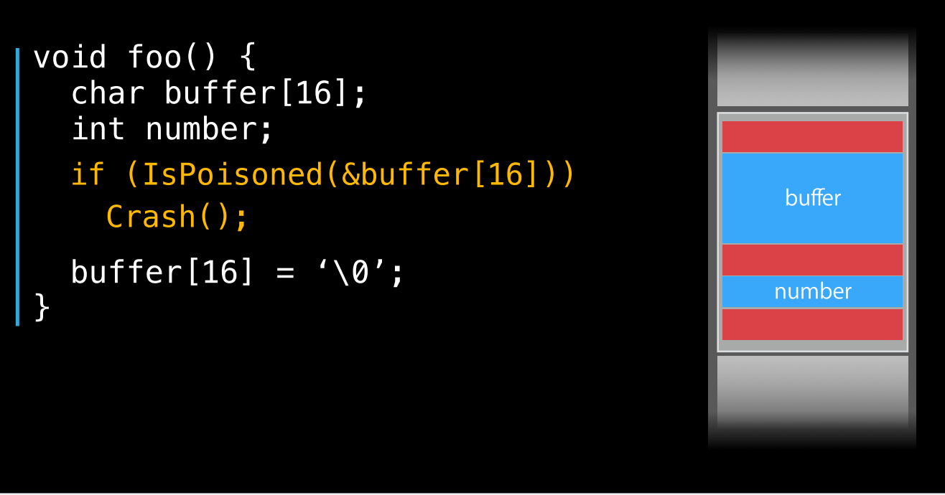
Compiler Instrumentation of the Stack
Notes:
Pseudo code

Slide 18
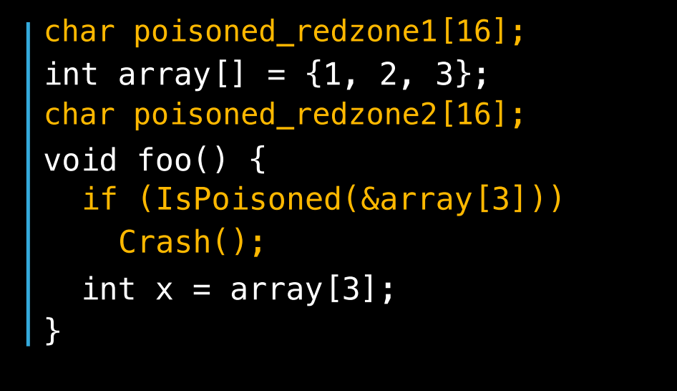
Compiler Instrumentation of Globals

Slide 19
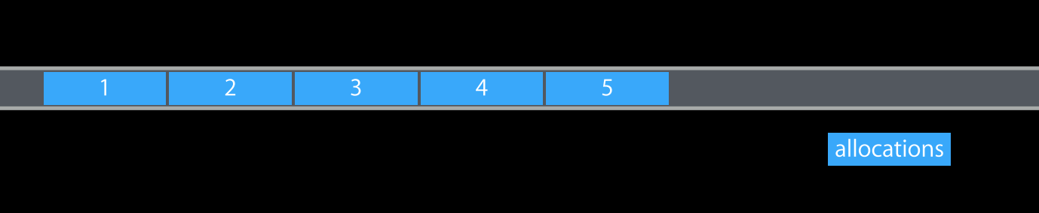
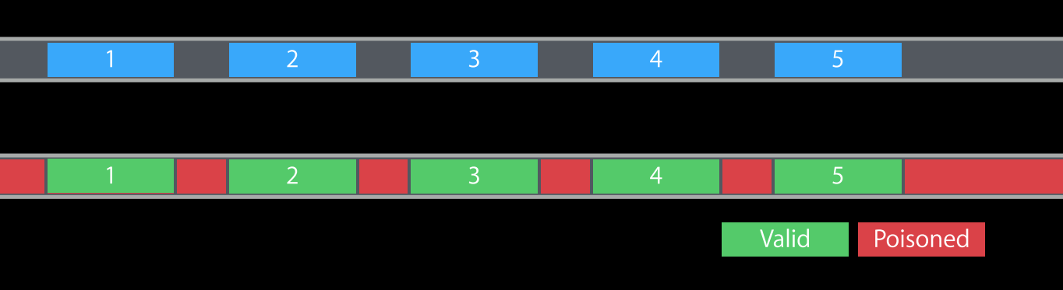
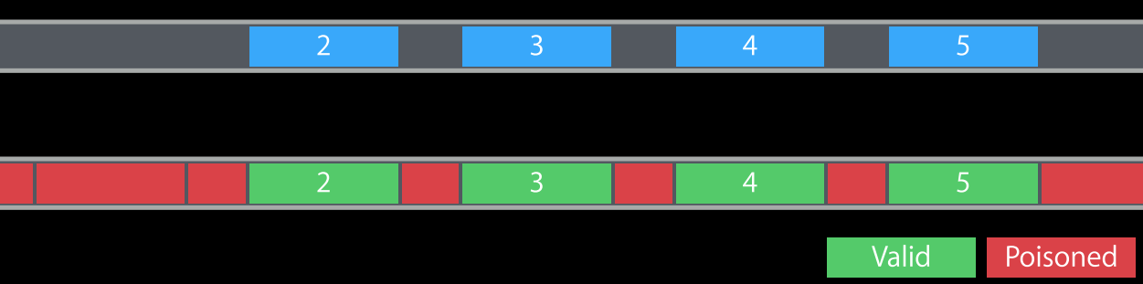
ASan Custom Malloc Implementation
Default Molloc
Asan Molloc
Asan Free

Slide 20
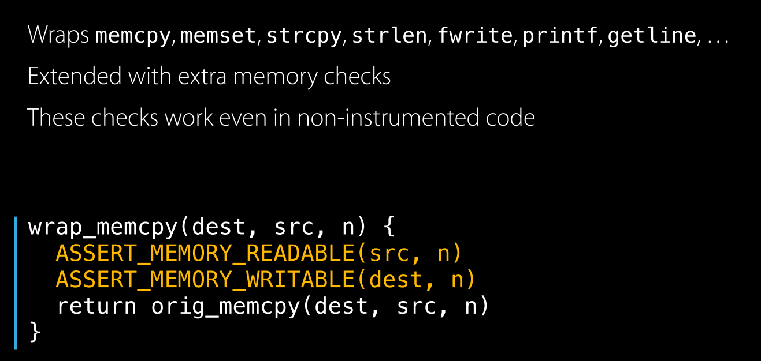
Runtime Function Interposition (optional for edk2)

Slide 21
Limitations
The biggest limitation is that the Asan principle cannot support structure inner members, which means the Asan can only protect very small part of the total firmware buffer in fact. See details in this link: https://groups.google.com/forum/#!topic/address-sanitizer/w9qmQ6TF4Ck.
But anyway, Asan already find bugs in its small supported part which means we have big potential to find more bugs :)
BTW, Intel MPX principle can protect structure inner members, but MPX is completely different and need more effort to enable.
Others
Structure Data
Asan
Support
part

Slide 22
Limitations
Code size cost is very high if not compressed (~10 times bigger)
Because build with -O0, -fno-lto for better call stack info
Only support DXE 64 bits so far, no plan for PEI
Need load and run the instrumented image in recovery mode from Usb disk
Only LLVM 4.0.0+ is supported, reason see comments in this slide
Notes:
Only LLVM 4.0.0+ is supported.
* LLVM3.8 Asan has a blocking limitation on the stack variable which is the Asan3.8 hardcode the Shadow Memory space (base address and offset of application virtual memory) in compiler, and cannot support allocate shadow memory space dynamically in runtime. But Uefi firmware need change the Shadow Memory space base and size according to platform real memory size from boot to boot. Fortunately, the latest LLVM main truck support the shadow memory dynamical allocation through -asan-force-dynamic-shadow build option and __asan_shadow_memory_dynamic_address global variable.

